Slide 1

JK Mobile Build - Architecture
Date: 11/27/2017

Slide 2
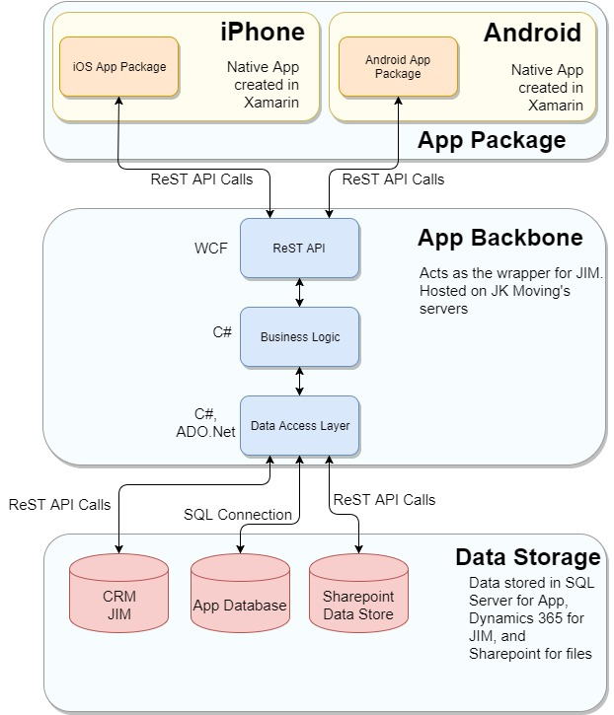
High Level Architecture

Slide 3
High Level Architecture
Application is divided in 3 major packages, explained below:
App Package
App package is developed in Xamarin and hosted on respective stores of iOS and Android.
Developed in Xamarin as Native Apps.
Connects to App Backbone using ReSTful API calls.
iOS App Package
This package contains iOS layouts, iOS specific code and shared code between iOS and Android.
Android App Package
This package contains Android layouts, Android specific code and shared code between iOS and Android.
App Backbone
Acts as service wrapper and interface between CRM and App packages.
Developed in WCF and C#, deployed on JK Moving's servers using IIS or on Azure Cloud.
ReST API
ReST style API used by app packages to consume data and access business logic.
Business Logic Layer
Business process related code, third party integration and security features.
Data Access Layer
Interfaces with CRM using Dynamics 365 integration services, with App data store using SQL Server
Data Storage
App Data Storage
App data stored in SQL Server instance hosted on JK Moving's server or on Azure Cloud.
CRM JIM
CRM implementation for JIM.

Slide 4
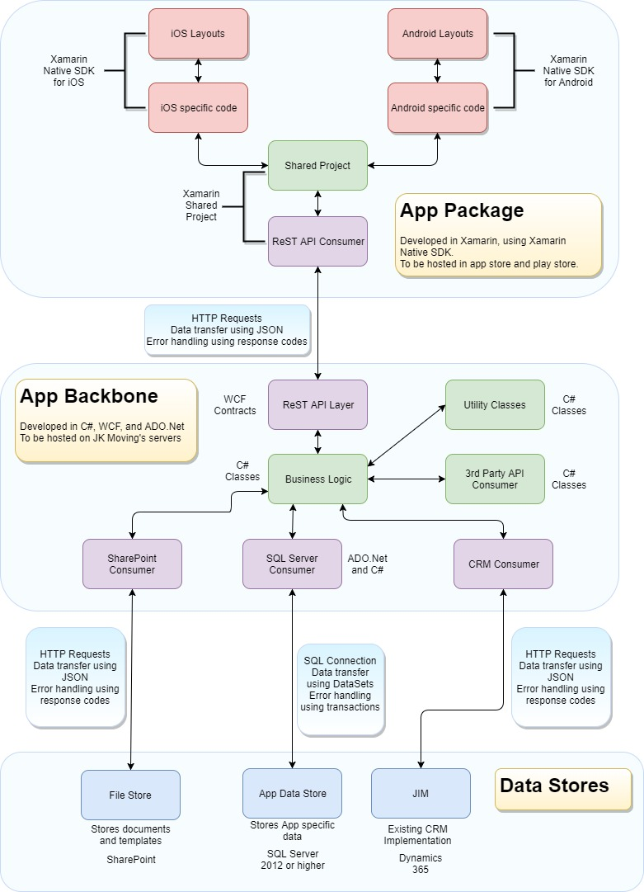
Detailed Architecture

